Slide 1
Emergency Response and Bed Availability Tracker
Name: Igiraneza Irene
Student ID: 27328
Institution: AUCA
Date: 19 December 2025
Course: PL/SQL Database Management
Github Link: https://github.com/ni-irene/thurs_27328_irene_emergency_response_and_bed_availability_-tracker_db

Slide 2
Problem Statement
In many hospitals, emergency patients often face delays due to poor tracking of available beds across wards. When critical cases arrive, staff must manually check which ward or unit has space, which wastes valuable time and can risk patient lives. This project aims to solve that problem by developing a PL/SQL-based Emergency Response and Bed Availability Tracker that keeps real-time records of hospital beds, patients, and admissions. It will automatically update bed status when patients are admitted or discharged and send alerts when beds are nearly full or all occupied.
- Manual bed tracking causes delays
- Emergency patients risk delays
- Poor visibility of bed availability

Slide 3
Proposed Solution
The system will use PL/SQL procedures, functions, and triggers to manage and automate hospital bed allocation and emergency admissions.
Key features include:
• Automatic bed status updates: When a patient is admitted, the corresponding bed is marked as 'Occupied’.
• Instant alerts: A trigger sends a notification (stored message or log entry) when a ward reaches full capacity.
• Emergency priority logic: Patients labeled as 'Emergency' are prioritized for available beds.
• Daily reports: A stored procedure generates a daily summary of available beds and admissions.
• Error handling: The system prevents double-booking of the same bed. This system will assist hospital administrators and emergency response units in making quick and accurate decisions during critical situations.
- Automated bed tracking
- Emergency prioritization
- Real-time updates
- Audit and compliance

Slide 4
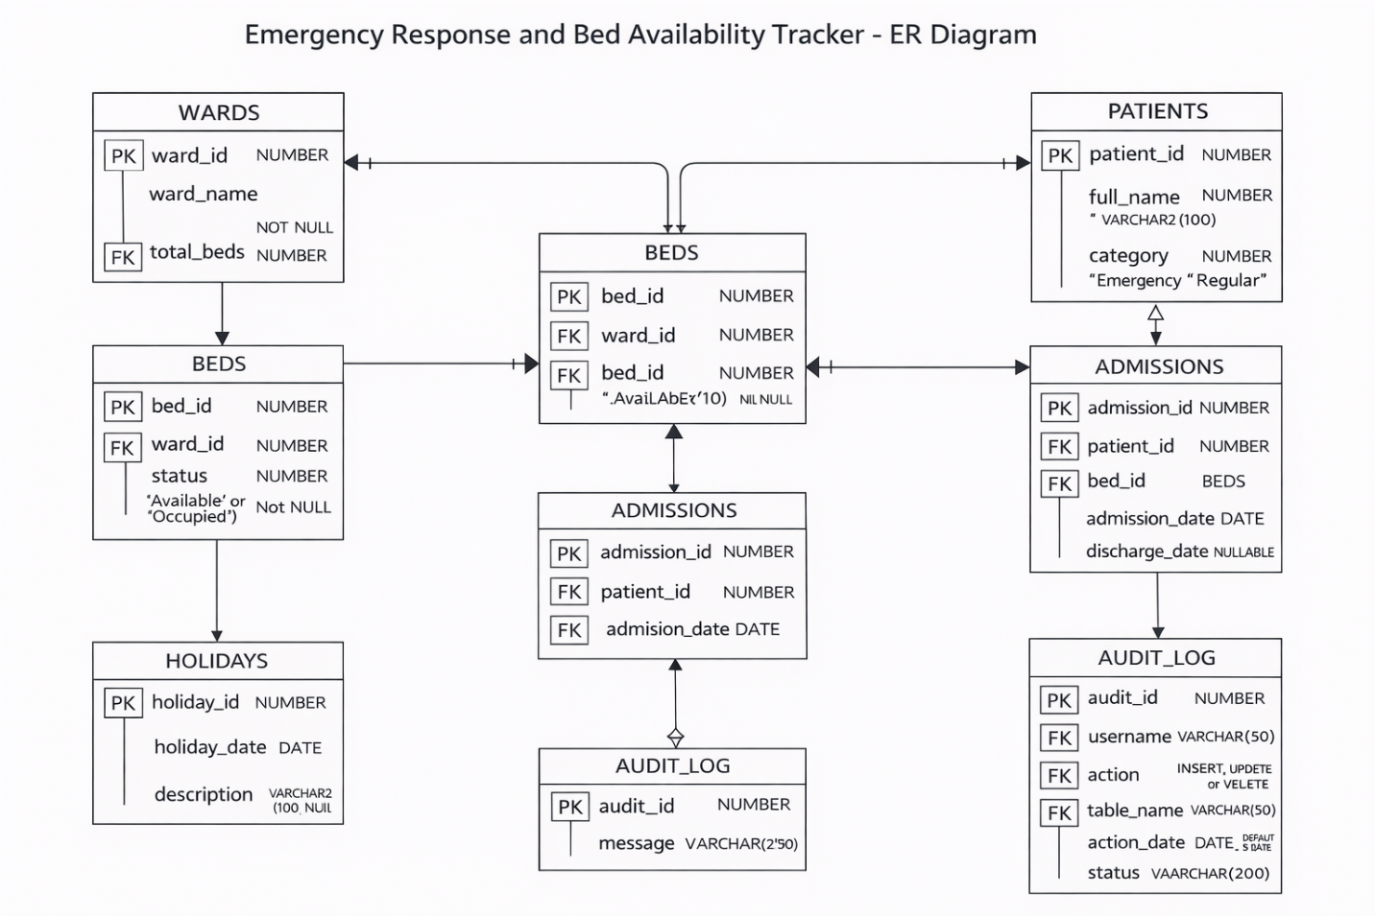
Database Design
WARDS
BEDS
PATIENTS
ADMISSIONS
AUDIT_LOG
PUBLIC_HOLIDAYS

Slide 5
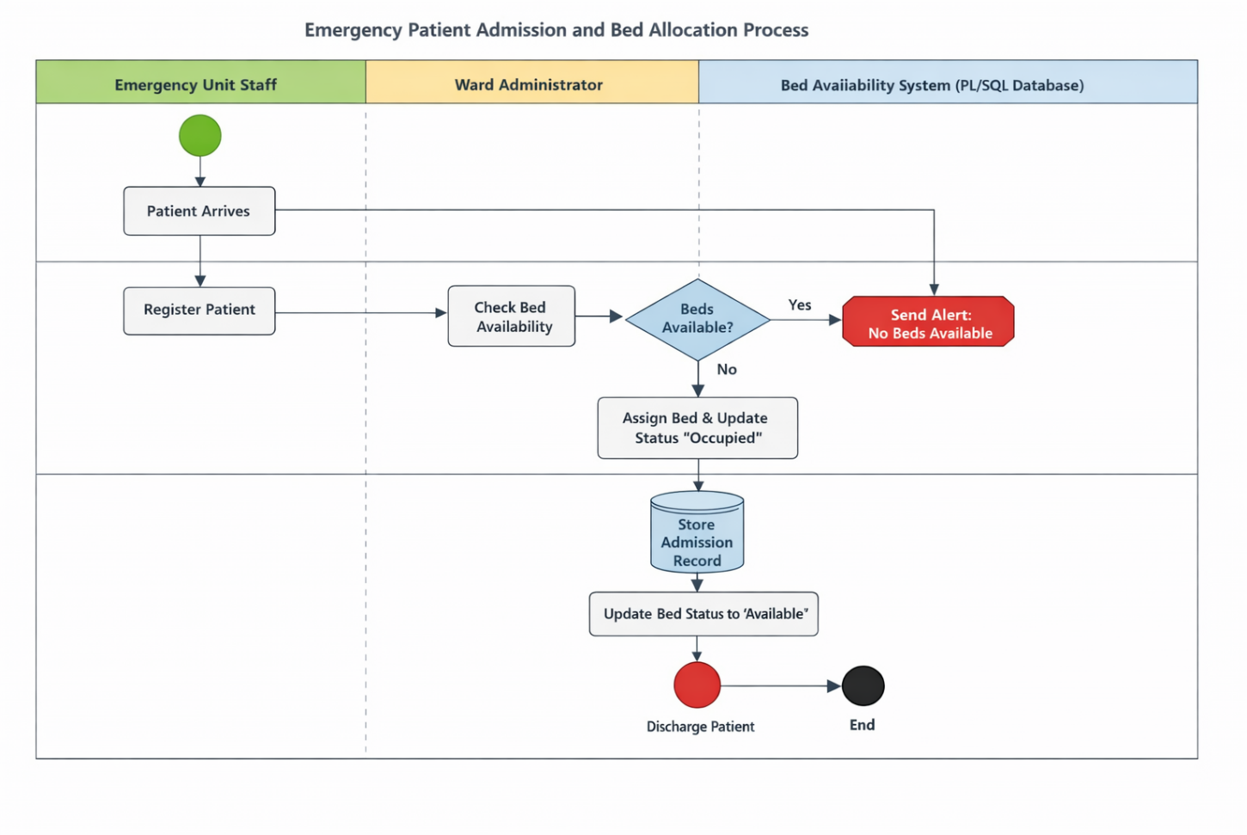
Business Process
- Patient arrives
- Bed availability checked
-Emergency prioritized
- Bed status updated
- Audit recorded

Slide 6
Technology Stack
- Oracle Database 21c XE
- PL/SQL
- SQL Developer
- Triggers, Packages and Functions
- GitHub

Slide 7
Advanced Features
- Simple & compound triggers
- Business rules
- Holiday restrictions
- Auditing
- Exception handling

Slide 8
Business Intelligence
- Bed occupancy KPIs
- Emergency trends
- Audit dashboard
- Performance monitoring

Slide 9
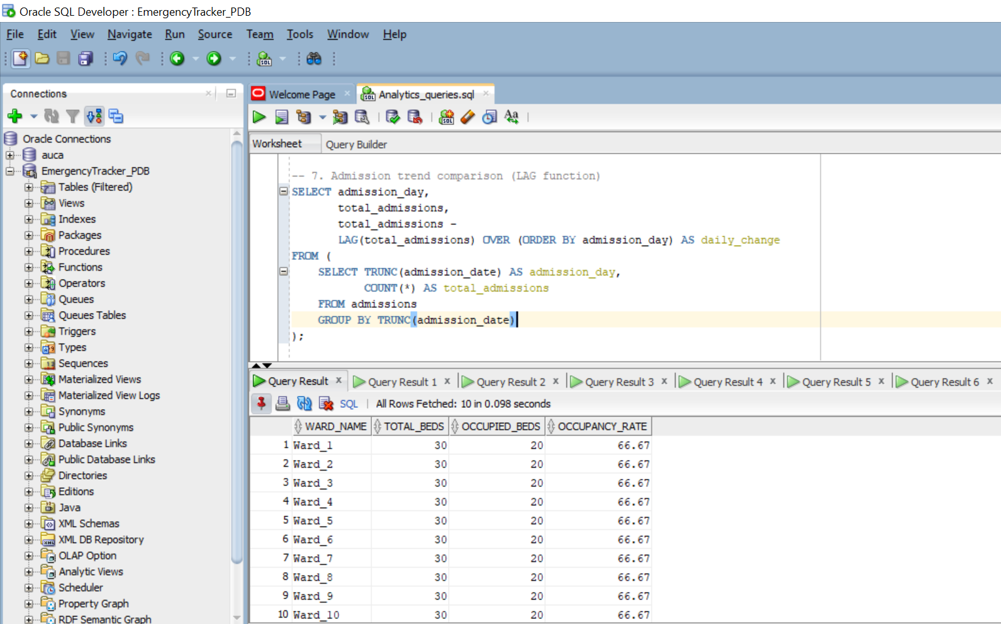
Results & Testing
- Triggers tested
- Business rules enforced
- Audit logs verified
- Data integrity ensured

Slide 10
Conclusion
- Improved emergency response
- Automated decision-making
- Secure and reliable system
- Questions
THANK YOU!!!

